Slide 1
Spreadsheet Project
Zomato Analysis
Prepared By: Gaurav Singh

Slide 2
ANALYSIS – OPENING NEW RESTAURANT
Analyzing Countries with less competition
States and Cities for opening new restaurant
Rating – in the suggested country
Total expenditure on food – in the suggested country
Competitors
Cuisines
Online delivery / table booking
Restaurants in different price range
Conclusion
Dashboard

Slide 3




COUNTRY
The selection of countries has been done on the basis of factor:
Average Ratings
Number of Restaurants

Slide 4
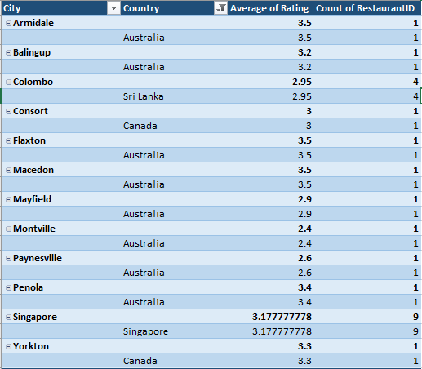
Country – SELECTED CITIES
Here are some cities which are suitable to open restaurants in our suggested country

Slide 5
AVERAGE RATING OF RESTAURANTS IN SELECTED COUNTRIES
COUNTRY | AVERAGE RATING
Australia | 3.6
Canada | 3.5
SINGAPORE | 3.5
Sri Lanka | 3.8
The ratings in the selected countries are in the range 3.67. The ratings are average giving insights that people are not fully satisfied with the restaurants. Also selected countries has less area and quite varieties in cuisines.
And hence its an opportunity for us to attract the people by providing the best of food and services.

Slide 6
Expenditure On Food
Current Expenditure on Food
Country | Current Expenditure($)
Australia | 375.7
Canada | 107.3
Singapore | 2305.1
Sri Lanka | 152

Slide 7
COMPETITOR ANALYSIS
BIGGEST COMPETITORS
LOWER BRACKETS
Restaurant Name | Country | Ratings
1918 Bistro & Grill | Australia | 4.4
5 Little Pigs | Australia | 4.1
Al'frank Cookies | Singapore | 4.2
Arabian Knights | Sri Lanka | 4.2
Burger's King | Sri Lanka | 4.1
Cut By Wolfgang Puck | Singapore | 4
Lake House Restaurant | Canada | 4.3
Restaurant Name | Country | Ratings
Consort Restaurant | Canada | 3
Elite Indian Restaurant | Sri Lanka | 2.4
Makansutra Gluttons Bay | Singapore | 3
Pier 70 | Australia | 2.6
Poets Cafe | Australia | 2.4
Queen's Cafe | Sri Lanka | 2.5
Star Buffet | Australia | 2.9

Slide 8
CUISINES with TOP RATINGS
These are the cuisines in the suggested four countries with high number of ratings.
These are some cuisines in all the four countries. It includes local food of that country and some other cuisines.
Top preference cuisines are American, Dessert, BBQ, Burger & Sandwich.

Slide 9
ONLINE DELIVERY /TABLE BOOKING
Delivery Analysis
Country | Online Delivery | Table Booking
Australia | 0 | 0
Canada | 0 | 0
Singapore | 0 | 0
Sri Lanka | 0 | 0
The selected four countries does not provide the option of online delivery / table booking.
This could be an opportunity for us. A market survey could be done to get insights about the preferences of the people about these.
Cost vs. Services: Explore if there is a relationship between the cost for two and the availability of table booking or delivery services. Analyze whether customers are willing to pay more for the convenience of these services.

Slide 10
Conclusion
After customizing and analyzing the given data, I analyze that the countries with lesser competition are Australia, Canada, Singapore and Sri Lanka on the basis of average ratings and the number of restaurants.
According to the data, Australia have average rating 3.6 and number of restaurants 24 , Canada has average rating 3.5 and number of restaurants 4, Singapore has average rating 3.6 and 20 restaurants while Sri Lanka has 3.8 average ratings and 20 restaurants.
Also the current expenditure of food in the suggested country is not that high as compared to other countries. The expenditure on food in Australia is 375.7 $, Canada has 107.3 $, Singapore has 2305.1 $ and Sri Lanka has 152 $.
The top cuisines in the selected countries that are performing well are American, BBQ, Sandwich, Burger, Italian, Continental and desserts. These are the most loved cuisines by the locals.
There are some competitors which are performing well in the selected countries. Some of them are 1918 Bistros & Grill, 5 Little pigs and Al’Franks Cookies.
In the suggested countries, there is no table bookings and online delivery. So, it’s a great opputunity to grow business with the new idea.

Slide 11
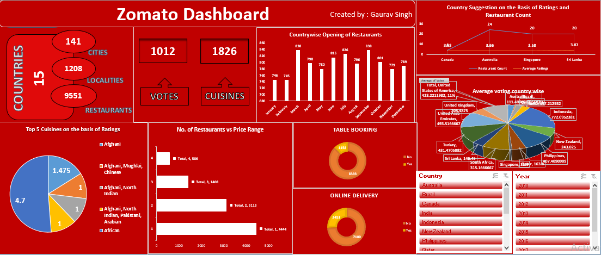
DASHBOARD

Slide 12
THANK YOU

